Slide 1

Two learning environments - Reflections
While there is a tendency to focus on either physical institutional learning environments (such as classrooms, lecture theatres and labs), or on the technologies used to to create online personal learning environments (PLEs), learning environments are broader than just these physical components.
Bates, A. W. (2015). Teaching in a Digital Age. Read Appendix 1: Building an effective learning environment. https://opentextbc.ca/teachinginadigitalage/chapter/5-2-what-is-a-learning-environment/)

Slide 2
Summary
This chapter set out to clarify the nature of formal learning as a basis from which to improve the way we design teaching. There are clear stakeholder views on the aims of formal education and the nature of the learning to be done. We have explored a range of views to define the scope of what the following chapters must cover. To summarize, over the past decade or so, there has been a developing consensus about the nature of formal learning:
• For the educational establishment: formal learning is not just about the detailed understanding of systems of ideas and explanations of the natural and social world that a traditional curriculum offers. It embraces equally the high-level cognitive skills that the knowledge society requires of its professional workforce.
• From the point of view of the workplace: fostering high-level generic cognitive skills is more important than the specific knowledge base for many professional areas. There is a tension to be resolved between the specialized development of codified knowledge in a discipline and the broader workplace demand for generic cognitive skills.
• From the educational theorists’ point of view: we need a careful balance of both specific discipline knowledge and generic cognitive skills. Specific knowledge will be peculiar to the discipline, but generic skills are widely applicable across the disciplines.
• From the teachers’ point of view: a large part of the formal curriculum, as expressed in learning outcomes, is common across subject disciplines, so it is feasible for teachers across different discipline areas to collaborate on discovering what it takes to help learners achieve high-level cognitive learning outcomes.
Laurillard, Diana (2012). Teaching as a design science [Elektronisk resurs]
building pedagogical patterns for learning and technology. 3. ed. New York: Routledge. Page 24

Slide 3
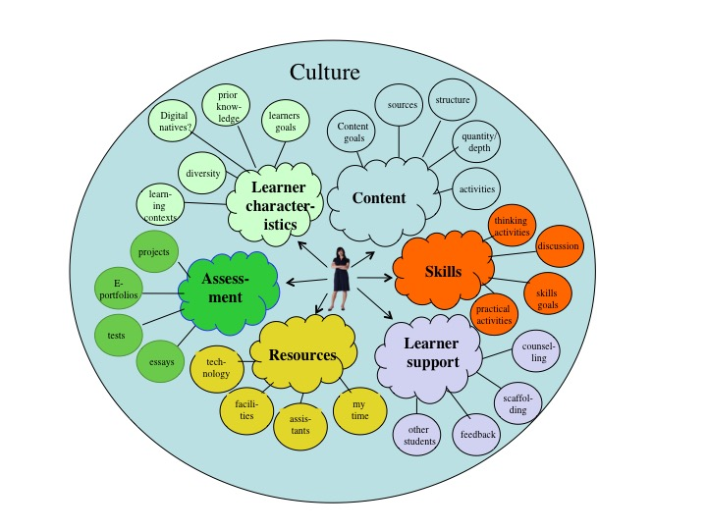
Bates, A. W. (2015). Teaching in a Digital Age. Read Appendix 1: Building an effective learning environment. Figure A.2.2 A learning environment from a teacher’s perspective. https://opentextbc.ca/teachinginadigitalage/chapter/5-2-what-is-a-learning-environment/

Slide 4
Cultural Learning Environment
How will the future turn out?
What´s happening in society/the world?
What is the teacher doing?
(expectations in the course)
Who am I?
Figure A: The cultural learning environment from a student’s perspective

Slide 5

Cultural Learning Environment for Students in History?
Learning Environment 1
Studying history at the University
”A contested dicipline”
Learning Environment 2
History in society/The world
”Why History matters”

Slide 6

Learning Environment 1
”A contested dicipline”
Studying history at the University
The status of the subject/program/course
Borderland between humanities and social science
Becoming a history teacher or not?
What skills do I need to develop to pass university?
”A contested dicipline” comes from Lauriard (2012) Teaching as a design
science: building pedagogical patterns for learning and technology pg 19.
”History is a highly contested dicipline”

Slide 7
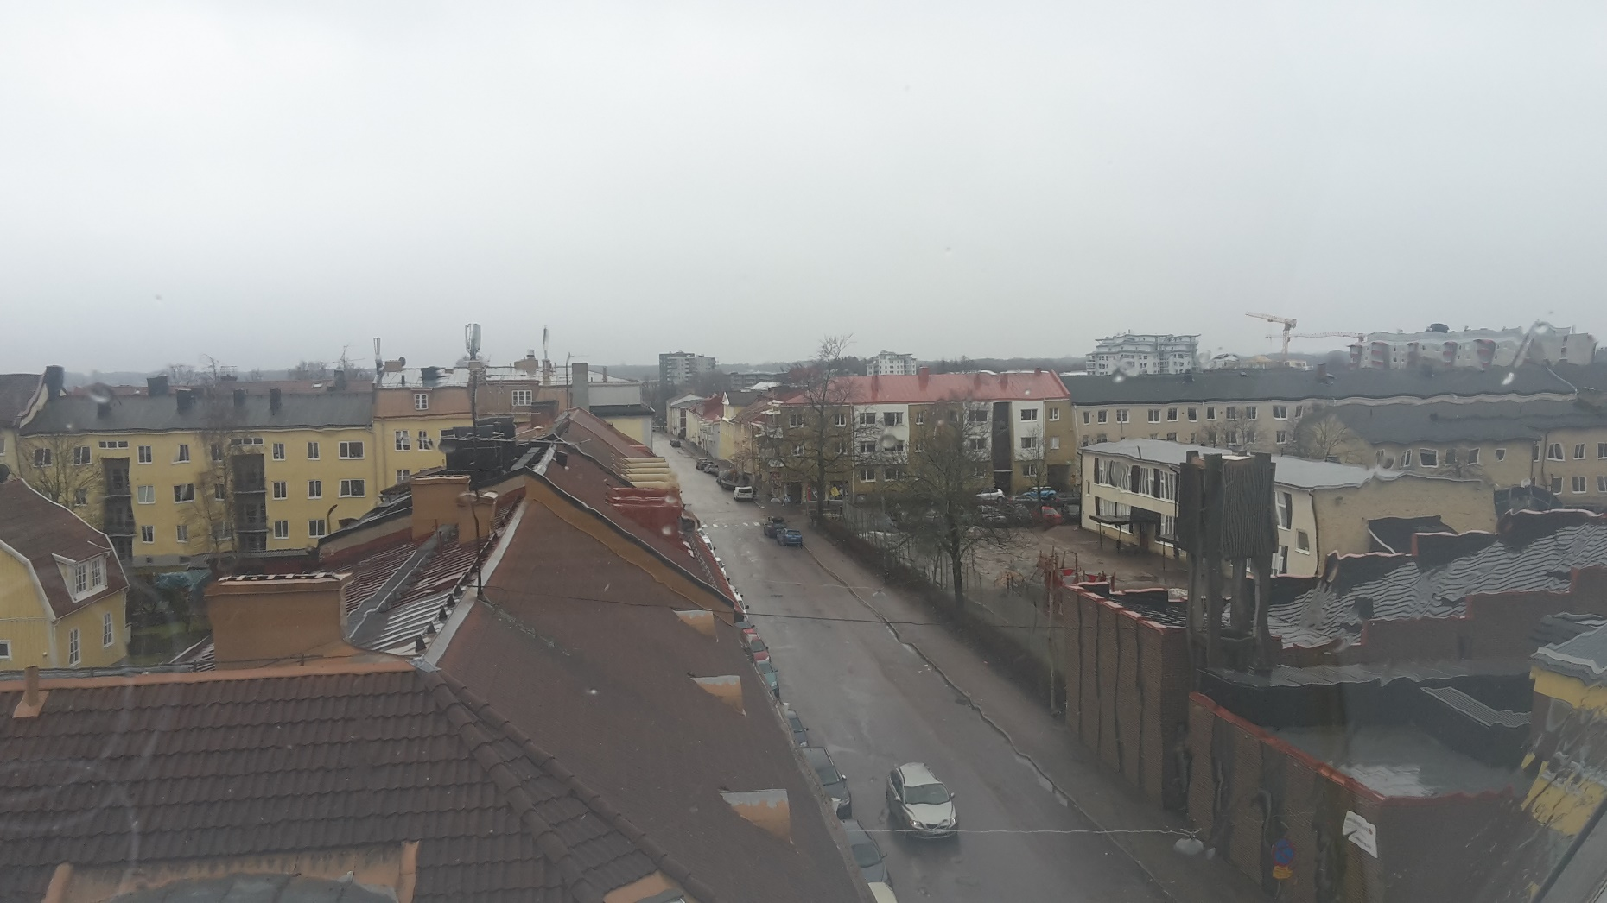
Learning Environment 2
”Why History Matters”
History in society/the world
The Knowledge/Post Industrial society
Fake news (What is truth?)
”Memory Wars”
Cultural heritage
Past – Present - Future
Intellectual skills
- Manage large amounts of information and
distinguish the essentials
- Critical thinking (and acting)
- Identification of power structures that
consolidate inequality
”Why History Matters” comes from: Hunt, Lynn (2018).
History: why it matters. Cambridge: Polity Press

Slide 8

”…[P]ublic interest in history is not simply rising; it´s skyrocketing.”
Hunt, Lynn (2018). History: why it matters.
Cambridge: Polity Press. Page 25.

