Slide 1
Learning environments – digital and in the class room
Notes:
Prepare a presentation with pictures and/or videos of two learning environments that you and the students work in during the course you have chosen or any other course. Preferably, choose one class room and one digital learning environment.
Reflect on the perspectives: Expected pedagogy, flexibility, digital possibilities, furnishing, light, air / ventilation, any other aspect you would like to highlight.
Make sure to use only pictures which you are allowed to use in order to enable you to post the presentation on your blog.
So, iv been thinking about the course that a have chosen and how it is structured. If we agree that teaching is a design sciences, an art of the artificial, on how it should be, how do we then design education in a digital world.

Slide 2
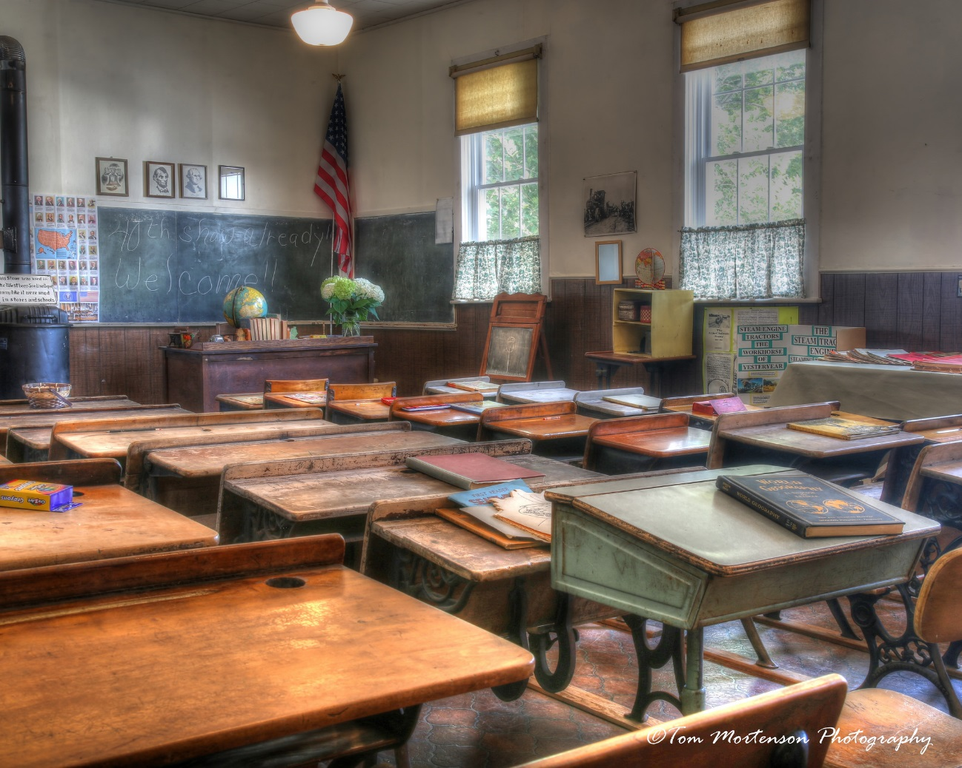
Human Safety III: Societal safety promotion
Notes:
This course is part of the maters program in risk and environmental studies. It is the third course covering the subject of human safety, with the first course covering how to explain the problem, the second how to solve the problem and the third how to implement an evaluate solutions. It is Usually a small group of students, around 10 in the class.
As this is a distance course it is mainly online based, but we start with a meeting at campus, and then they are of to work on there own and after ten week they return to the classroom.

Slide 3
The course
Week | Learning environment | When | Task within the project | Personal feedback/feed forward
1 | Campus meeting | During class | Choosing subject | In class form teacher and peers
2-3 | Online, low tech | At home | Needs assessment, program theory | From teacher on canvas
4-5 | Online | At home | Practical implications | From teacher on canvas
6-7 | Online | At home | Evaluation plan | From teacher on canvas
8 | Online | At home | Discussion and conclusions | From teacher on canvas
9 | Online | At home | Final submission and reading other students work | From peers, give and get reflections and questions
10 | Campus meeting | In class | Seminar discussion | From peers and teacher
Notes:
This is the outline of the course. It constitutes of one project that is handed in in four parts.
Explaining the parts.

Slide 4
In the class room
Notes:
With as few students as 10 the classical class room offers many possibilities. Over the years we have learned that it is important for the students to choose subject right away, otherwise some tend to have difficulties getting started.
I guess the expected in this room is traditional lecturing, but that is something that can be done online so instead the time on campus is used for other purposes.

Slide 5
The first meeting on campus
Residential fires
Falls
Drowning
Floating device
Exercise
Alarms
Notes:
At this point the students are generally highly skilled and very use to studying.
We use the time together in the room preferably to discuss. If needed we change the furnishing of the room so that we can sit together and talk, instead of me talking.
I introduce the assignment that they are going to work with. They are use to this step wise way of working from the previous courses and therefore know what to expect. This is important, they are experienced and this gives us the opportunity to rise the expectations on there achievements.

Slide 6
Online period
Canvas
Speed grader
Notes:
Expected pedagogy, flexibility, digital possibilities, furnishing, light, air / ventilation, any other aspect you would like to highlight.
During the online periods there are a lot of opportunities.
I guess the primary learning environment is canvas, meaning that the structure there is important. canvas is the building, and maybe speed grader is there classroom.
It is on speed grader that they get feedback and feed forward, it is a place for communication. A lot of the students also use other tools for interaction during this period, they will right messengers, mail and call us.
The online time is the time were we can’t control their environment. They can organize is how ever they like.
A problem is technology that isn't working. There is often difficulties with audio and video connections.

Slide 7
The course
Week | Learning environment | When | Task within the project | Personal feedback/feed forward
1 | Campus meeting | During class | Choosing subject | In class form teacher and peers
2-3 | Online, low tech | At home | Needs assessment, program theory | From teacher on canvas
4-5 | Online | At home | Practical implications | From teacher on canvas
6-7 | Online | At home | Evaluation plan | From teacher on canvas
8 | Online | At home | Discussion and conclusions | From teacher on canvas
9 | Online | At home | Final submission and reading other students work | From peers, give and get reflections and questions
10 | Campus meeting | In class | Seminar discussion | From peers and teacher
Notes:
Looking at it like this, it visualizes how much of the course that are online and how important it is to make an effort and work on these parts.

Slide 8
Before campus
Residential fires
Falls
Drowning
Floating device
Exercise
Alarms
Notes:
Before the last meeting they give each other comments and questions.

Slide 9
Final meeting
Notes:
And in the last meeting theses what we discuss, they get to reply of the comments and questions. Again, we try to create a relaxed environment and atmosphere were they can learn from each other.

